Slide 1
Cell Transport
Reference HB11 – Chapter 4

Slide 2
Objectives
1. I can explain why materials need to be transported in different ways between cells (material size and composition).
2. I can describe the different ways substances are transported in cells (diffusion, osmosis and cytosis).
3. I can describe how facilitated diffusion operates.
4. I can define diffusion as the net movement of a substance from an area of high concentration to an area of low concentration.
I can define and describe the process of osmosis

Slide 3
Pre-reading
Work through the following websites, read the information and complete the Tests.
https://www.bbc.co.uk/bitesize/guides/zc9tyrd/revision/5
https://www.bbc.co.uk/bitesize/guides/zc9tyrd/revision/2

Slide 4
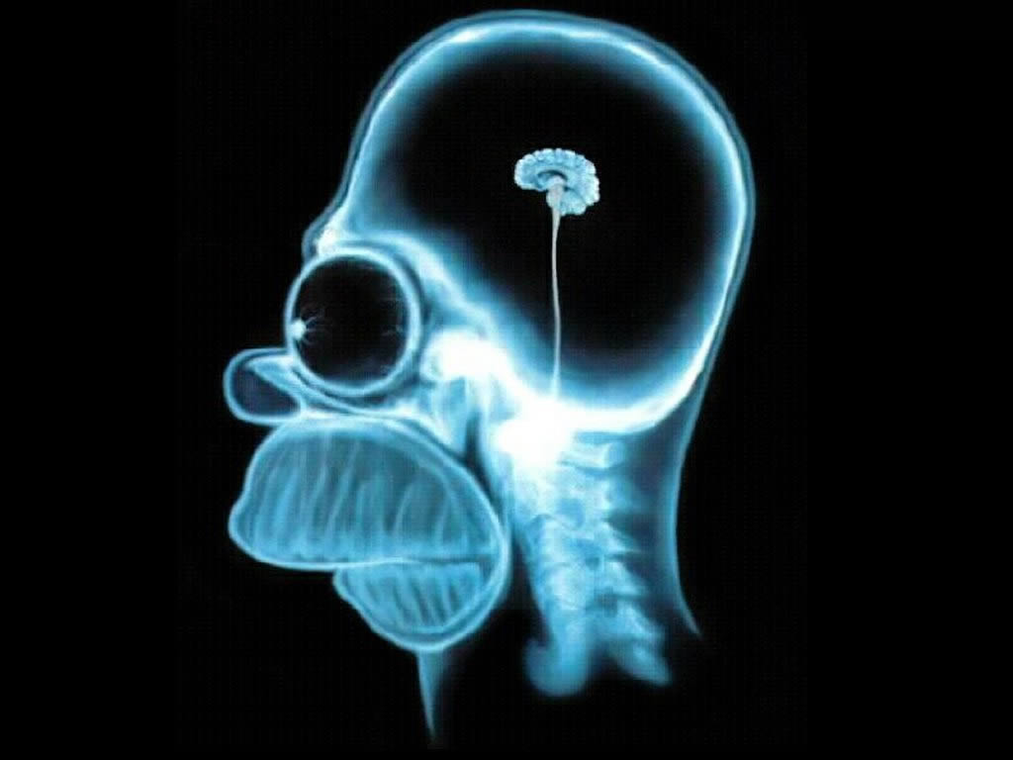
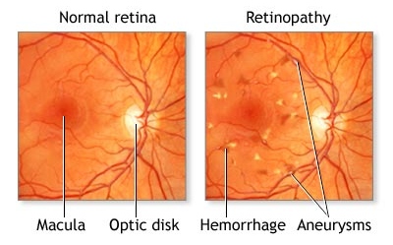
Cell requirements
To enable normal functioning all cells in the human body need to be in a relatively stable environment.
Some like brain and retina cells are very susceptible to even slight variations in glucose, oxygen and temperature.
Other cells such as skin cells are able to cope with a much wider range of conditions eg temperature.

Slide 5
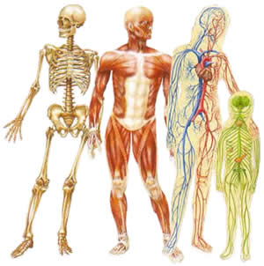
Cell requirements
One of the ‘roles’ of the body systems is maintain a continual supply of the materials needed eg glucose and oxygen and a continued removal of waste materials eg carbon dioxide and urea.

Slide 6
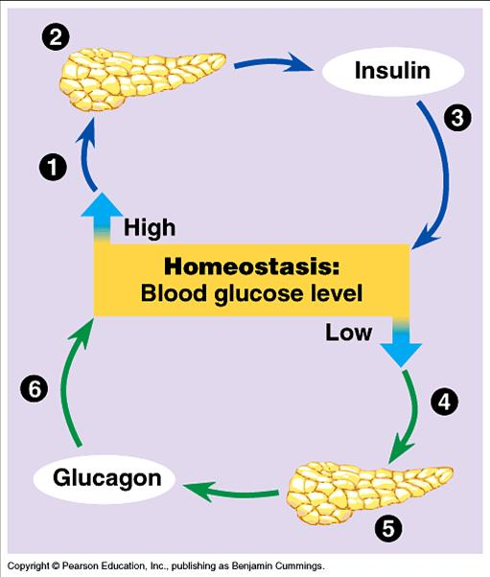
Cell requirements
Body systems work together to make sure that the cellular environment is kept constant.
This is called homeostasis.
The systems operate in such a way that if a particular factor becomes too high or too low they will function to return the factor to its best or optimal level.

Slide 7
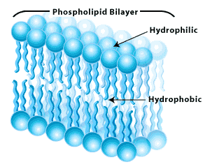
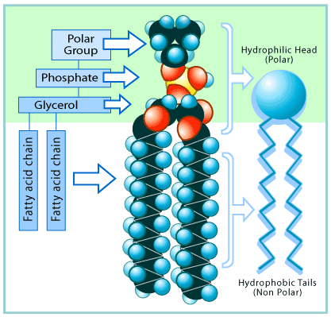
Cell membrane structure
The cell membrane is composed mainly of lipids and proteins.
They are arranged into two layers that make up the single membrane.
It is known as a bilayer.
Substances and molecules move through the membrane in different ways.
How they are moved depends on their size and if they are organic or inorganic.

Slide 8
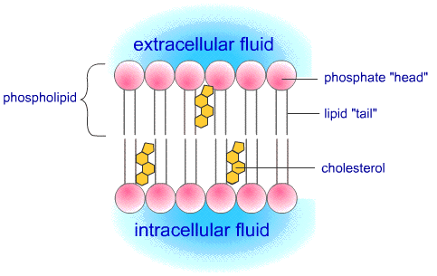
Cell membrane structure
Very small molecules eg oxygen can pass through the small gaps between the lipids.
Fat soluble substances such as alcohol and steroid hormones can diffuse across the membrane by ‘dissolving’ into the lipid (fat).

Slide 9
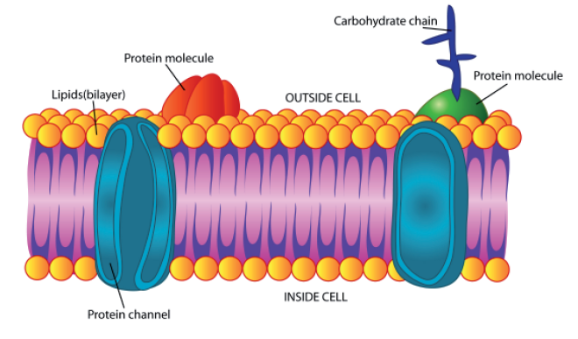
Cell membrane structure
Proteins are embedded through the membrane and they carry out most of the functions of the membrane.
They can be divided into two types.
Integral proteins that bridge the two sides of the membrane
Peripheral proteins embedded in the outside of the membrane.

Slide 10
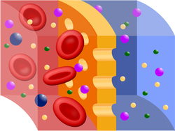
Transport across the cell membrane
Cell membranes are described as being differentially permeable. They allow some ions and molecules to pass through, but restrict the movement of others, this is usually based on size.
Differentially permeable membranes may also be called semi-permeable or selectively permeable membranes.

Slide 11
Video - Introduction
4. AS_Cell Transport (7.25 min)

Slide 12
Passive & active processes
Materials may pass through a cell membrane in a number of different ways.
Some transfer mechanisms are passive processes which means that there is no requirement to expend energy.
Passive processes will occur in both living and dead cells and are almost impossible to prevent. The three types of passive transport processes are Diffusion, Osmosis & Facilitated diffusion.
Active processes require the cell’s energy for the transfer to occur. This means that they only occur in living cells. The two types are active transport and cytosis.

Slide 13
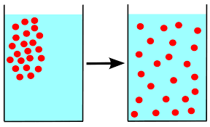
Diffusion
Diffusion is the movement of molecules from an area of high concentration to an area of low concentration.
Diffusion only occurs when there is a difference in concentration between the two areas eg a concentration gradient.
Diffusion is a passive process; it does not require the expenditure of energy.
Diffusion can occur in almost any circumstance where molecules can move, it is not confined to cells.

Slide 14
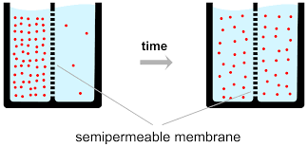
Diffusion
In cells, molecules will diffuse across the cell membrane if they are small enough to fit through the gaps between the lipids.
Once there is no concentration gradient, although diffusion continues to occur due to the kinetic energy of the molecules, the ‘end’ or Net result is no change.
Oxygen, carbon dioxide and alcohol pass through the lipid bilayer by diffusion.

Slide 15
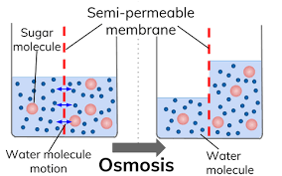
Osmosis
Osmosis is a special case of diffusion that involves the diffusion of water across a cell membrane.
Water molecules are very small and so pass through easily.
Osmosis occurs when water moves from an area of high concentration of water to an area of low concentration of water.

Slide 16
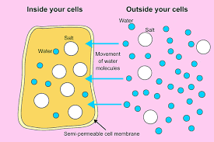
Osmosis
In a solution if there is a high concentration of water (solvent) then there must be a low concentration of solute i.e. a dilute solution.
In a solution if there is a low concentration of water (solvent) then there must be a high concentration of solute i.e. a concentrated solution.
Osmosis is a passive process i.e. it does not involve the expenditure of energy.

Slide 17
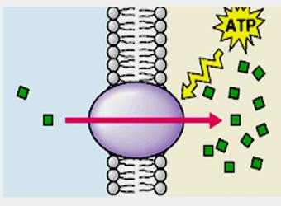
Active Transport
Active transport is the movement of molecules from an area of low concentration to an area of high concentration i.e. against a concentration gradient.
Active transport is an active process and requires the use of ’cellular energy’; therefore it only occurs across living cell membranes.

Slide 18
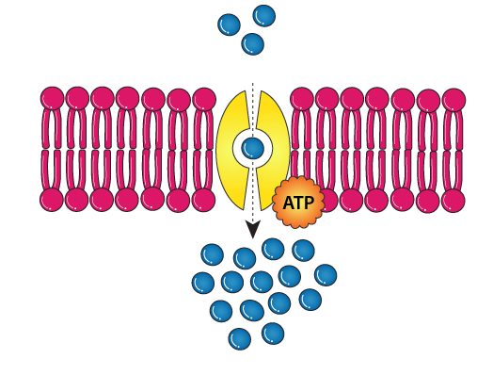
Active Transport
It can only be used for ‘small’ molecules as they have to pass through the cell membrane.
The ’cellular energy’ is used to provide ‘power’ to proteins in the cell membrane that ‘ferry’ the molecules across the cell membrane.

Slide 19
Cytosis
Cytosis is an active process in which materials move into or out of the cell enclosed as vesicles.
Vesicles are bubble-like structures consisting of either a solid particle or a liquid droplet enfolded in a piece of the cell membrane.
It is used for materials such as large particles that are too ‘large’ to ‘fit’ through the pores or protein channels in the cell membrane.
The material and its surrounding piece of cell membrane is called a a vesicle.
It is an active process and requires the use of ’cellular energy’; therefore it only occurs in living cell membranes.

Slide 20
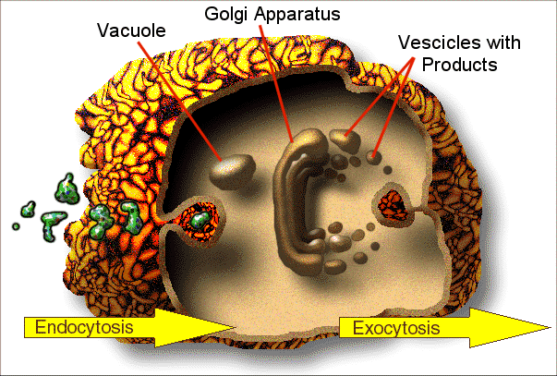
Exocytosis
Exocytosis is when the material/particle in a vesicle is moved from inside the cytoplasm to the ‘outside’.
Materials/particles passed out of a cell by exocytosis may be a waste product or may be a substance that the cell has made for use elsewhere eg Milk from breast cells, saliva from salivary gland cells.

Slide 21
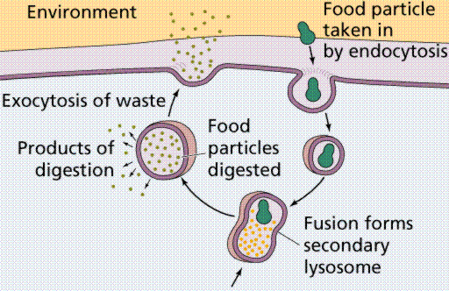
Endocytosis
Endocytosis is when the material/particle is moved from ‘outside’ the cell into the cytoplasm.
If the material/particle is ‘solid’ it is called phagocytosis, if the material/particle is a ’liquid’ it is called pinocytosis.
All cells carry out pinocytosis but phagocytosis is performed only by specialised cells eg White blood cells.

